Slide 1
How to Model Reinsurance in AIR
TIGERRISK PARTNERS

Slide 2
Goals
The goal for this training is to teach new analysts how to create a reinsurance program in AIR to be applied in modelling
Analysts should be able to complete the following after this training;
Create a reinsurance program in AIR
Create XPR, Quota Share, Surplus Share, and Catastrophe reinsurance treaties
Understand how the background tables work in regards to Facultative and Surplus Share reinsurance

Slide 3

00.
TIGERRISK PARTNERS Creating a Reinsurance Program

Slide 4
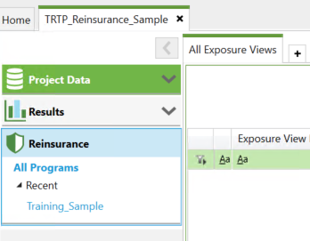
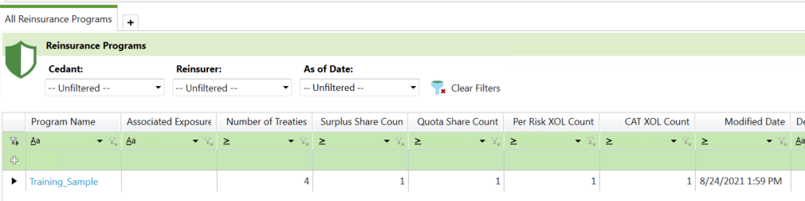
Creating a Reinsurance Program
00.
In your client project, navigate to the reinsurance tab
Create a new program
To do this, type the program name in the first row of the table
Name it something easily recognizable so you can differentiate if needed

Slide 5
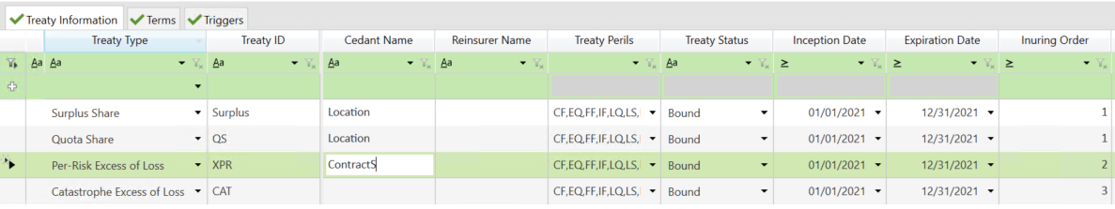
Good to Know Information
00.
AIR assigns a day of year to every event
Because of this, we will almost always model XPR, Surplus Share and Quota Share reinsurance with inception and expiration dates about 10 years higher/lower than the actual date
This is because using the actual one year date range can result in some weird rounding in the model
Inuring Order will change how reinsurance is applied in modelling
Anything with an inuring order greater than one will cause treaties to be applied deterministically, not stochastically
Note this is changing in AIR’s next generation financial model
AIR requires location/layer level treaties to apply before contract level treaties, and all treaties must apply before catastrophe treaties

Slide 6
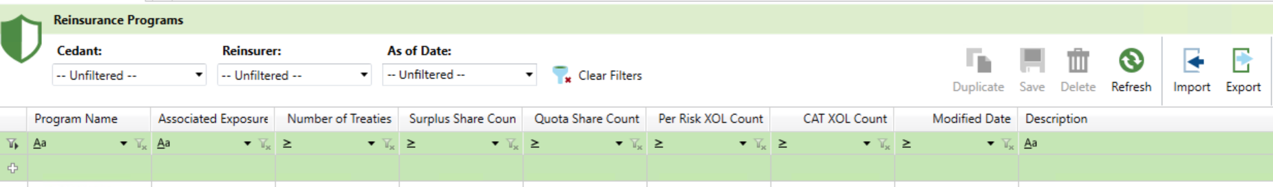
Good to Know Information
00.
Sometimes clients provide us their own reinsurance files which can be imported directly into your project.
Simply navigate to where the file is saved using the import utility in the reinsurance interface
You can also export the reinsurance program to a file by using the export utility
You will need to type out the full network file path in the file name as AIR does not let you navigate to the saved folder
\\rdutrfs01.tigerrisk.local\R_Drive\02_CLIENTDATA\ClientName\REINSURACEFILE.rpx

Slide 7
01.
TIGERRISK PARTNERS Facultative Reinsurance

Slide 8
Facultative Reinsurance
01.
Unlike the other types of reinsurance, facultative (FAC) reinsurance is modeled completely in the background of the model
A file is imported along with the contract and location file which contains links to the exposure data and details what reinsurance covers the individual risks
FAC can cover risks at either the location or policy level and will have an attachment point, limit and participation amount
FAC detail is stored in the tReinsAppliestoEXP table in your CEDE database
Once the data is imported it will automatically be applied in your modelling

Slide 9
Sample Import File
01.
Contract ID | Reinsurance Type | Reinsurance ID | Exposure Type | Exposure ID | Ceded Percentage | Reinsurance Limit | Attachment Amount | Currency
32768 | FAC | 2543 | LOC | 784666 | 1 | 15,000,000 | 20,000,000 | USD
32768 | FAC | 2544 | LOC | 784666 | 1 | 15,000,000 | 35,000,000 | USD
45462 | FAC | 2555 | LOC | 814728 | 1 | 2,500,000 | 27,000,000 | USD
47406 | FAC | 2702 | LOC | 830778 | 1 | 9,619,961 | 50,000,000 | USD
32786 | FAC | 2547 | LOC | 784820 | 1 | 3,551,092 | 20,000,000 | USD
15558 | FAC | 2206 | LYR | 19796 | 1 | 78,739,000 | 50,000,000 | USD
15622 | FAC | 2213 | LYR | 19860 | 1 | 32,273,000 | 50,000,000 | USD
29347 | FAC | 2530 | LYR | 22565 | 1 | - | 67,467,737 | USD
46779 | FAC | 2696 | LYR | 51019 | 1 | 35,000,000 | 49,990,000 | USD
15602 | FAC | 2211 | LYR | 19840 | 1 | 26,000,000 | 50,000,000 | USD
Contract ID links to the account ID that is imported with your data
Exposure type and exposure ID are then used to link to the appropriate data
Notice how in some cases an individual location can have more than one FAC layer
There are also cases where there is a limit of zero, which the model interprets as unlimited

Slide 10
02.
TIGERRISK PARTNERS Surplus Share

Slide 11
Surplus Share
02.
Surplus share treaties are a bit of a mix between a quota share and facultative covers and modelling them requires data to be imported and for there to be an accompanying treaty in the model interface
The data that gets imported contains the location/layer specific details and can be imported at the same time as the facultative data
The only difference is that reinsurance type changes from FAC to SS
This data then links to the model interface via the Reinsurance ID in the import file, this ID must be the treaty name for the reinsurance to apply

Slide 12
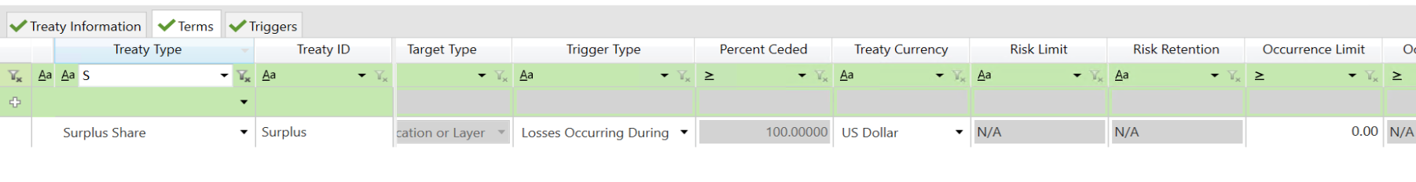
Surplus Share
02.
In the AIR interface you can set an occurrence limit and/or aggregate limit to the treaty
The Treaty ID NEEDS to be the same as the reinsurance ID in the import file otherwise the treaty will not work

Slide 13
03.
TIGERRISK PARTNERS Excess Per Risk (XPR)

Slide 14
Excess Per Risk
03.
XPR treaties are by far the most common type of reinsurance you will use within the model
The treaty ID can be any distinct ID (XPR 1, XPR 2 etc.) and the treaty can either apply at the contract level or the Location/Layer Level
You will always have a risk limit/retention for the treaty along with an occurrence limit and percent placed
Aggregate limits are available in AIR only
You can filter which exposure applies to the treaty by setting a distinct line of business
This can be multiple LOBs in a comma separated format

Slide 15
04.
TIGERRISK PARTNERS Quota Share

Slide 16
Quota Share
04.
Quota Shares cede off a set percentage of business
In AIR you can set which business applies via either Area or Line of business
RMS does not allow you to apply regional quota shares
Similar to the other types of treaties you set an occurrence limit and aggregate limit (if applicable)
The treaty can apply at the location or layer level

Slide 17
05.
TIGERRISK PARTNERS Catastrophe Layers

Slide 18
Catastrophe Layers
05.
Typically, we model catastrophe layers in TigerEye, but some situations may call for you to use it within the model
These treaties will only have occurrence and aggregate values, these apply at the portfolio level rather than the exposure level
The only major difference for these treaties is that you can adjust the number of reinstatements
Usually, cat layers have one or two reinstatements

Slide 19
06.
TIGERRISK PARTNERS Homework

Slide 20
Homework
06.
Apply the following reinsurance terms to your analyses using one reinsurance Program
10% Quota Share applied to all Contracts
Excess per risk treaty with the following terms at the location level
$1M xs $1M
$3M Occurrence Limit
$6M Aggregate Limit
Catastrophe Reinsurance Layer
$10M xs $10M
90% placed
One Reinstatement

Slide 21


